Slide 1
QlikSense Training
I&D India – QlikSense CoE

Slide 2
Session 02

Slide 3
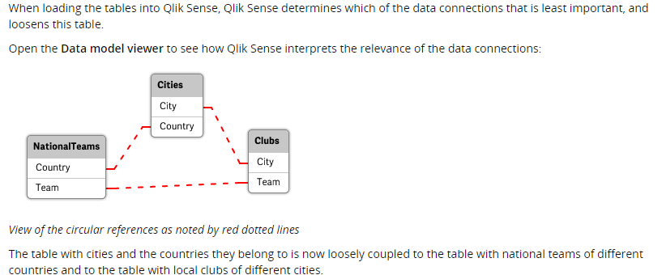
Circular References

Slide 4
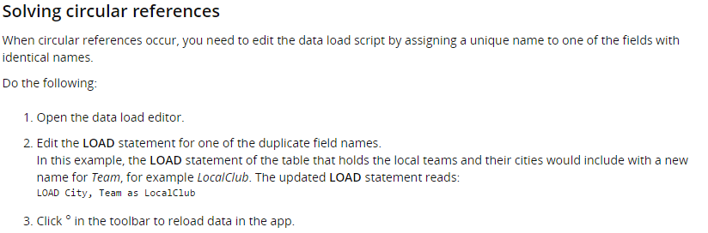
Circular References

Slide 5
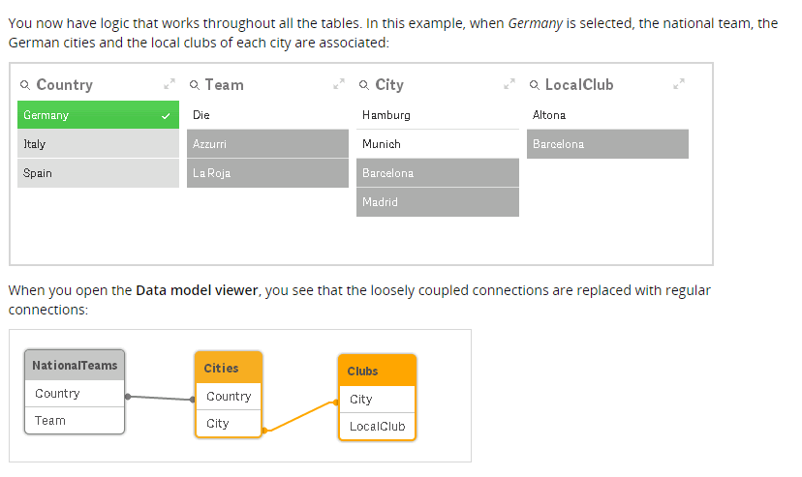
Circular References

Slide 6
Synthetic Keys
What are Synthetic Keys or Tables?
When we load 2 tables with a common field name in both tables, the tables get associated automatically based on common fields. This is the associative fuctionality of Qliksense.
When we have more than one common field between two or more tables Qliksense creates ‘SYNTHETIC KEYS’ and ‘SYNTHETIC TABLE’. It add these tables in data model
Synthetic key is Qliksense method to deal with composite keys The Synthetic table contains a synthetic key that is a composite of all the combinations of the multiple key fields connecting the tables.

Slide 7
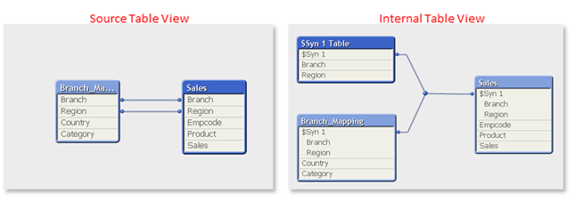
Synthetic Keys
Example

Slide 8
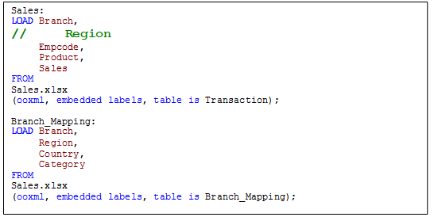
Synthetic Keys
How to remove Synthetic Keys?
To remove synthetic keys, we first look at our data model and make necessary changes, if required. We have multiple methods to remove synthetic keys but it depends upon the requirement
Removing fields: When common fields causing synthetic keys are not required in data model and doing so will not affect the relationship between two tables. Removing fields can be done by commenting or removing field from load script.

Slide 9
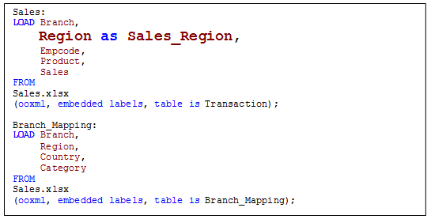
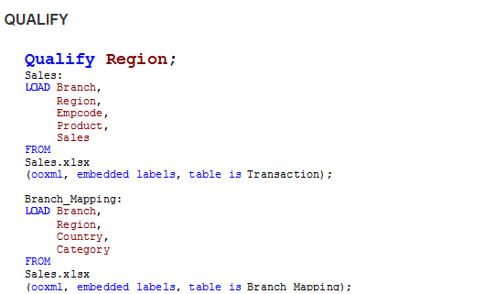
Synthetic Keys
Renaming fields (Using QUALIFY):
When common fields causing synthetic keys are not same field (not containing similar values), These are actually different fields with same name. Renaming can be done by using “AS” clause. We can also achieve this by using QUALIFY statement. With qualified statement, fields names are converted in the “TableName.FieldName” format

Slide 10
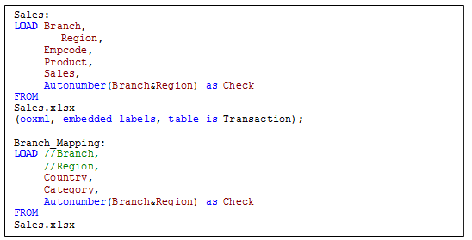
Synthetic Keys
Autonumber/ Composite Keys:
When we know common fields causing synthetic keys are important for data model then we can create our own key to handle composite keys.
We can also use Autonumber / Autonumberhash128 / Autonumberhash256 functions to create composite keys. These will create a unique bit value for each distinct combination of the concatenated columns. Autonumberhash128 and Autonumberhash256 creates 128bit and 256bit values respectively.

Slide 11
Thank You

